Slide 1
Introduction to Demand Forecasting
Nayanita Bhattacharyya
Business Analyst
March 2026

Slide 2



Forecasting Impact
All about balancing Demand & Supply
E.g.,
Sony PlayStation 5 (PS5) Shortage
2020–2023
Supply
D > S
Stock outs/Lost Revenue
Customer dissatisfaction
>
Demand
Demand
E.g.,
Hand Sanitizers
Post-Pandemic 2022
D < S
High Inventory Costs
Obsolescence
<
Supply
Demand
=
Supply
E.g.,
Amazon Prime’s "Anticipatory Shipping" System
D = S
High Customer Service
Low Inventory Costs

Slide 3
Types of Forecasts
Forecasting
Micro Forecasting
Macro Forecasting
Operational Forecasting
Strategic Forecasting
Short-term forecasting
Long-term forecasting
Production, Procurement, Logistics, Financial Planning
Capacity planning, Marketing strategy,
Merger and Acquisitions

Slide 4


Characteristics of forecasts
1. Forecasts are (almost) always wrong
2. All Products are Not equally forecastable
No one has a crystal ball. The objective is to minimize error in the forecast.
Cost of an Error and Error Tolerance depends upon: Adjustment Capability of an organization
New, highly promoted, shorter life cycle, and intermittent (sporadic or lumpy) demand products are generally more difficult to forecast
Accuracy generally increases for group of products rather than for an individual product

Slide 5




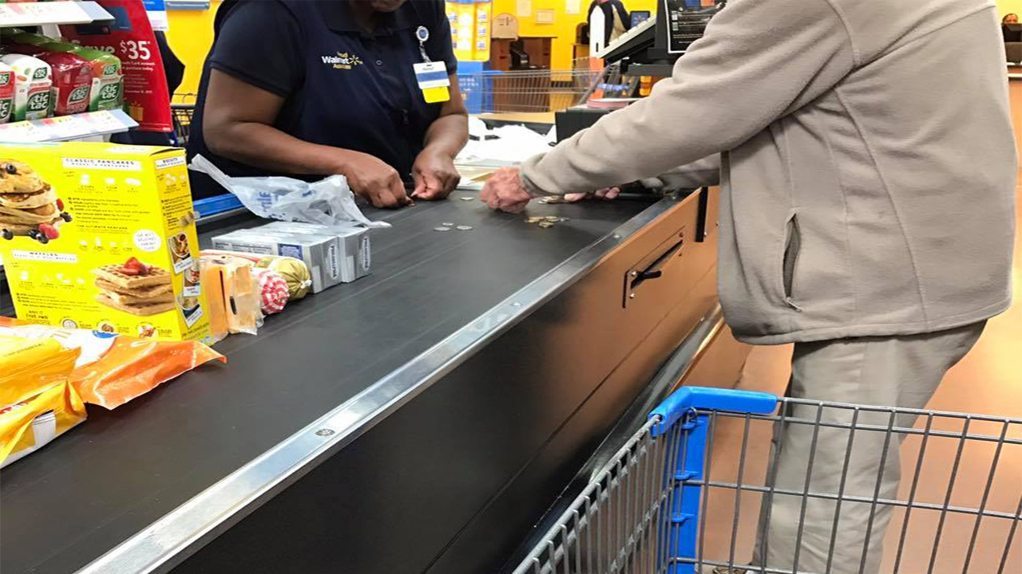
Characteristics of forecasts
3. Demand Forecasts better than Shipment Forecasts
4. Consumer-centric demand better than customer-centric demand
Demand (Order) forecasts provide better information about the changing market dynamics and customer needs.
Shipment forecasts based on demand forecasts are generally more accurate.
Consumer-centric (end-users) demand is more stable, and thus more predictable.
Very often manufactures push their products to distributors/retailers by offering incentives to meet their targets even with little or no change in the consumer demand.
2- Orders
1- Point of Sale
3 Shipments
Supplier/Manufacturer
Customer
Consumers

Slide 6

Characteristics of forecasts
5. Each function has its own bias
6. Near-term forecasts are more accurate than Long-term
Demand forecasts must include an estimate of how large the forecast error is likely to be (Bias)
E.g., Production teams could tend to over-forecast if they are evaluated based on customer service
E.g., Sales teams could tend to under-forecast for the fear of missing targets
Further the demand forecast is extended into the future, higher the forecast inaccuracy
Forecast horizon depends on the lead time (time to produce a product)
Forecasts are more useful if prepared early enough to react

Slide 7


Characteristics of forecasts
7. Variations in Demand
8. When forecasts are not needed
Variations in demand by Businesses – promotions to meet quarterly and/or annual targets.
Variations in demand by Outside Factors – Storms, Riots, Competitive actions etc.
Future is expected to be the same as the past.
Enough time to react, i.e., your cycle time is shorter than the customer’s cycle time.
Forecasts will be the same as budget.
Products are always made to order.

Slide 8



Kimberly-Clark Case Study
Kimberly-Clark(the makers of Huggies and Kleenex) successfully implemented a 'Demand Sensing' forecasting system to align production with actual consumer behavior. This eliminated the 'Bullwhip Effect' and saved hundreds of millions in inventory costs.
The Challenge
Legacy Forecasting
Relied on 6-month-old historical shipping data. High "Forecast Lag" led to excess inventory and stockouts.
The Implementation
Real-Time Integration
Partnered with retailers (Walmart/Target) to pull daily Point-of-Sale (POS) data directly into the forecasting engine.
The Result
Precision & Savings
Achieved a 35% increase in forecast accuracy. Reduced excess inventory by 19% while improving customer service levels.
What Went Right?
Real-Time Data (System)
The System sensed demand, it didn't guess it. By using "Downstream Data" (actual sales), the system reflected what was happening in stores today, not months ago.
Continuous Monitoring (Process)
Errors were caught in 24 hours. A daily automated process monitored for "Forecast Bias”.
Cross-Functional Trust (Integration)
One forecast for everyone. Sales, Finance, and Supply Chain all worked from the same data, ensuring the entire company moved in sync with the customer.

Slide 9

Forecasting: A Rocket Science?
SCIENCE through Data Modeling
-mathematical models to create forecast from historical data
ART through Business Consensus
-agreeing on one number forecast

Slide 10
Thank you

Slide 11



Zara Case Study: Mastering Demand-Driven Forecasting
Real-Time Sensing
Store managers capture customer feedback and real-time sales data daily. This removes the "guesswork" from the forecast.
Agile Manufacturing
Store managers capture customer feedback and real-time sales data daily. This removes the "guesswork" from the forecast.
Rapid Replenishment
New designs reach stores twice a week. The short lead time (15 days) ensures the inventory always matches current demand.
Success Metrics
High Full-Price Sales: 85% of items are sold at full price (industry average is much lower).
Customer Loyalty: Customers visit Zara stores 17 times a year on average because the "forecasted" stock is always fresh and relevant.
Low Waste: Minimal unsold inventory due to highly accurate, short-term forecasting.

